Slide 1


Introduction

Slide 2
What is a compiler?
  A program that reads a program written in one language (Source Language) and translates it into an equivalent program in another language (Target Language).
  Traditionally, the source language is a High Level Language and the target language is a Low Level Language (machine code).

Slide 3
Compiler
Target
program
Source
program
Error message

Slide 4
Source program with macros
Preprocessor
A typical compilation & Execution process
Source program
Compiler
Target assembly program
Assembler
Relocatable machine code
Linker/Loader
Absolute machine code

Slide 5
Overview of
Compilation Process

Slide 6
Overview
Compiler phases
  Lexical analysis
  Syntax analysis
  Semantic analysis
  Intermediate (machine-independent) code generation
  code optimization
  Target (machine-dependent) code generation
Notes:
COP4020 Fall 2006

Slide 7
Source program
Lexical Analyzer
Syntax Analyzer
Semantic Analyzer
Error Handler
Symbol Table
Management
Intermediate Code Generator
Code Optimization
Code Generation Phase
Target program

Slide 8
Source program
Lexical Analyzer
Syntax Analyzer
Semantic Analyzer
Error Handler
Symbol Table
Management
Intermediate Code Generator
Code Optimization
Code Generation Phase
Target program

Slide 9
Source program
Lexical Analyzer
Syntax Analyzer
Semantic Analyzer
Error Handler
Symbol Table
Management
Intermediate Code Generator
Code Optimization
Code Generation Phase
Target program

Slide 10
Source program
Lexical Analyzer
Syntax Analyzer
Semantic Analyzer
Error Handler
Symbol Table
Management
Intermediate Code Generator
Code Optimization
Code Generation Phase
Target program

Slide 11
Source program
Lexical Analyzer
Syntax Analyzer
Semantic Analyzer
Error Handler
Symbol Table
Management
Intermediate Code Generator
Code Optimization
Code Generation Phase
Target program

Slide 12
Source program
Lexical Analyzer
Syntax Analyzer
Semantic Analyzer
Error Handler
Symbol Table
Management
Intermediate Code Generator
Code Optimization
Code Generation Phase
Target program

Slide 13
Source program
Lexical Analyzer
Syntax Analyzer
Semantic Analyzer
Error Handler
Symbol Table
Management
Intermediate Code Generator
Code Optimization
Code Generation Phase
Target program

Slide 14
Source program
Lexical Analyzer
Syntax Analyzer
Semantic Analyzer
Error Handler
Symbol Table
Management
Intermediate Code Generator
Code Optimization
Code Generation Phase
Target program

Slide 15
Source program
Lexical Analyzer
Syntax Analyzer
Semantic Analyzer
Error Handler
Symbol Table
Management
Intermediate Code Generator
Code Optimization
Code Generation Phase
Target program

Slide 16
Front End and Back End Model of Compiler
Source
Program
IR
Target
Program
Frontend
Backend
Analysis and Synthesis Phase of Compiler
Source
Program
Analysis
IR
Synthesis
Target
Program

Slide 17




Compiler Front End – Back End / Analysis –Synthesis Phase
Abstract Syntax Tree or
other intermediate form
Source Program (character stream)
Scanner
(Lexical Analysis)
Intermediate Code Generator
Set of Tokens
Parser
(Syntax Analysis)
Modified Intermediate Form
Front End / Analysis
Back End / Synthesis
Code Optimization
Parse Tree /
Syntax Tree
Optimized Code
Semantic Analysis
Target Code Generation
Assembly or Object Code
Abstract Syntax Tree or
Annotated Parse Tree

Slide 18
Standard Compiler Structure
Source code
(character stream)
Lexical analysis
Token stream
Front end
(machine-independent)
Parsing
Abstract syntax tree
Intermediate Code Generation
Intermediate code
Optimization
Intermediate code
Back end
(machine-dependent)
Code generation
Assembly code

Slide 19
Lexical Analysis
Also known as Scanner/ Linear Analysis.
It scans the input string from Left to Right Character by Character and forms Set of Valid Tokens.
Tokens are nothing but the Sequence of Characters which is having Valid meaning.
( Meaningful smallest unit of Program is Token).

Slide 20
Terms used in Lexical Analyzer are-
LEXEME-Smallest Logical Unit (Word) of Program.
{ I, sum, buffer, for,10,+ …}
TOKEN –Set of Similar Lexemes.
Identifier - { I, sum, buffer …}
Keyword – { for, ….}
Number – { 0, 23, ….}
PATTERN- as good as Regular Expression
DIGIT [0-9]

Slide 21
Lexemes that are not passed to the Parser
White Spaces (WS) – Tab, Blanks, New Lines
Comments
These too have to be detected and Ignored.
The Lexical Analyzer:
Detects the next Lexeme
Categorizes it into the right token.
Passes to the Syntax Analyzer
- the token name for further syntax analysis
- the lexeme itself, in some form, for stages beyond syntax analysis.

Slide 22
Basic task of Lexical Analyzer:
Recognizing Basic Elements:
Removal of White Spaces and Comments.
Recognizing Constants and Literals.
Recognizing Keywords and Identifiers.
< token, token value>
Ex: < id, .>
< no, 9>
Pointer to Symbol Table Entry

Slide 23
Tokens
Token stream: Each significant lexical chunk of the program is represented by a token
  Operators & Punctuation: {}[]!+-=*;: …
  Keywords: if while return goto
  Identifiers: id & actual name
  Constants: kind & value; int, floating-point character, string, …

Slide 24
Example:
position = initial + rate * 60
Tokenized to:
position : The identifier
= : The Assignment Operator
initial : The identifier
+ : The Plus Operator
rate : The identifier
* : The Multiplication Operator
60 : The Number/ Constant

Slide 25

position
=
initial
+
rate
*
60
id1
opr
id2
opr
id3
opr
num
id1 = id2 + id3 * 60

Slide 26
Basic Concept and Issues
Where does the Lexical Analyzer fits into the rest of Compiler?
The front end of most compilers is Parser Driven.
When the parser needs the next Token, it involves the Lexical Analyzer.
Instead of analyzing the entire input string, the lexical analyzer sees enough of the input string to return a single Token.
Parser
Lexical Analyzer
Rest of the Compiler
Input Program
Lexical Analyzer acts as a Sub-routine.

Slide 27
Scanning process of Lexical Analyzer
Read Character
Input
Lexical Analyzer
Parser
Push Back Character
Pass Token & its Attributes
ex: operator <=

Slide 28
Lexical and Syntactic Structure of Language
p*q-r => p*(q-r) or (p*q)-r which is correct ??
What
How

Slide 29
Design of Lexical Analyzer
Every action is implemented by Transition Diagram
TG for Identifiers, Keywords, Operators…
Regular Expression.
Finite Automata.

Slide 30
Two Approaches
1.Hand Code : This is only of historical interest now. (possibly more efficient)
2.Use Generator : To generate the lexical analyzer from a format description.
- The generation process is faster.
- Less prone to Errors.
… LEX …

Slide 31
LEX
LEX Compiler
Example.l
lex.yy.c
C
Compiler
lex.yy.c
a.out
a.out
Set of Tokens
Input

Slide 32
LEX Specification
Declaration Section : Variable, Manifest Constant, Regular Definition.
Translation Rules Section
P1 ………. { action1}
P2 ………. { action2}
P3 ………. { action3}
P4 ………. { action4}
Subroutine Section
%{
%}
{
%%
%%
Compulsory Section

Slide 33
Commands Used:
# lex filename.l
# cc lex.yy.c –ll
# ./a.out
Input:??

Slide 34
Implementing the Interactions
Uses getchar() In
C to read a Character Returns Token to Caller
Pushes back ch using
ungetc(ch,stdin) Sets a global variable to attribute value (yylval)
Lexical Analyzer
Lex Value / Token Value
Back

Slide 35
Scanner: Lexical Analysis
  What kind of errors can be reported by lexical analyzer?
  Misspelling of Keywords.
Back

Slide 36

Getting Bored……..??!!
  Try Some Examples ….
  L E X

Slide 37
Write a LEX program to find out whether given input is a Letter or Digit
Write a program to find out whether given input is a Noun, Pronoun, Verb, Adverb, Adjective or Preposition

Slide 38

Role of Parser / Syntax Analysis
Token
Parse Tree
Source
Program
Lexical Analyzer
Parser
Rest of Front End
Intermediate
Representation
Get Next Token
Symbol Table
Position of Parser in Compiler Model

Slide 39
Role of Parser / Syntax Analysis
Checks whether the token stream meets the Grammatical Specification of the Language and generates the Syntax Tree.
  A grammar of a programming language is typically described by a Context Free Grammar, which also defines the structure of the parse tree.
  A syntax error is produced by the Parser.

Slide 40
Context-Free Grammars
A context-free grammar defines the syntax of a programming language
The syntax defines the syntactic categories for language constructs
  Statements
  Expressions
  Declarations
Categories are subdivided into more detailed categories
  A Statement is a
    For-statement
    If-statement
    Assignment
<statement> ::= <for-statement> | <if-statement> | <assignment>
<for-statement> ::= for ( <expression> ; <expression> ; <expression> ) <statement>
<assignment> ::= <identifier> := <expression>

Slide 41
Where Syntax Analysis fits?
If(idx == 0) idx = 750 ;
Lexical Analysis

Slide 42
Where Syntax Analysis fits?
If(idx == 0) idx = 750 ;
Lexical Analysis
If ( idx == 0 ) idx = 750 ;
Syntax Analysis

Slide 43
Where Syntax Analysis fits?
If(idx == 0) idx = 750 ;
Lexical Analysis
If ( idx == 0 ) idx = 750 ;
Syntax Analysis
If
IsEq
Assign
Abstract Syntax Tree
idx
0
idx
750

Slide 44
Goal:
Discard irrelevant information to make it easier to the next stage.
( parenthesis, most of the punctuations are removed)
Ex: (2*3)+4;
Syntax Tree ??

Slide 45
Goal:
Discard irrelevant information to make it easier to the next stage.( parenthesis, most of the punctuations are removed)
Ex: (2*3)+4;
2
Syntax Tree

Slide 46
Ex: (2*3)+4;
2
3
Syntax Tree

Slide 47
Ex: (2*3)+4;
*
2
3
Syntax Tree

Slide 48
Ex: (2*3)+4;
*
4
2
3
Syntax Tree

Slide 49
Ex: (2*3)+4;
+
*
4
2
3
Syntax Tree
Lexical Analyzer acts as a Sub-routine.

Slide 50
Parser / Syntax Analysis
Token
Parse Tree
Source
Program
Lexical Analyzer
Parser
Rest of Front End
Intermediate
Representation
Get Next Token
Symbol Table
Position of Parser in Compiler Model

Slide 51
Syntax Error Handling
Program can have Errors at different Levels
- Lexical Errors
- Syntactic Errors
- Semantic Errors
- Logical Errors
Who handles these Errors ?

Slide 52
ERROR HANDLER
Simple Goals:
It should report the presence of Errors clearly and accurately.
It should recover from each error quickly enough to be able to detect subsequent errors.
It should not significantly slow down the processing of correct program.
Errors can be:
60% Punctuation Errors
20% Operators & Operands Errors
15% Keywords Errors
5% Other kinds of Errors

Slide 53
Error Recovery Strategies
Panic Mode ( Discarding)
Phrase Level ( Local Correction)
Error Production ( Additional Grammar)
Global Correction ( All at once)

Slide 54
T O C
Revision of
Types of Grammar (Type 0, Type 1, Type 2, Type 3)
Derivation Trees :
- Leftmost Derivation
- Rightmost Derivation
Parse Tree & Syntax Tree
Components of CFG { N, T, P, S }
Ambiguous Grammar
Removal of Ambiguity

Slide 55
Parsing Techniques Imp
Parser

Slide 56
Parsing Techniques Imp
Parser
Top-Down Parser
Bottom-Up Parser

Slide 57
Parsing Techniques Imp
Parser
Top-Down Parser
Bottom-Up Parser
Recursive Descent Parser
Predictive [LL(1)] Parser

Slide 58
Parsing Techniques Imp
Parser
Top-Down Parser
Bottom-Up Parser
Recursive Descent Parser
Predictive [LL(1)] Parser
Shift-Reduce Parser
LR Parser

Slide 59
Parsing Techniques Imp
Parser
Top-Down Parser
Bottom-Up Parser
Recursive Descent Parser
Predictive [LL(1)] Parser
Shift-Reduce Parser
LR Parser
LALR Parser
Canonical LR Parser
SLR Parser

Slide 60
Top Down –Recursive Descent Parser
Parse Tree from Root to Leaves:
Uses Backtracking:
Backtracking is making repeated scans of the input (productions) till the match is found.
Ex: given grammar
S -> cAd
A-> ab / a
W = cad

Slide 61
Top Down Con…
Predictive Parser (LL(1))
Here (LL(1))
Scans Input from Left to Right

Slide 62
Top Down Con…
Predictive Parser (LL(1))
Here (LL(1))
Scans Input from Left to Right
Generates Leftmost Derivation Tree

Slide 63
Top Down Con…
Predictive Parser (LL(1))
Here (LL(1))
One (1) Look ahead Symbol
Scans Input from Left to Right
Generates Leftmost Derivation Tree
we can have (LL(k)) parsers also

Slide 64
No Backtracking Parser:
Writing Special Grammar – Eliminating
Left Recursion & Left Factoring.
Must know – Current Input Symbol (a)
& Non terminal (A) to be expanded.
A -> α1/ α2 / α3 ……/ αn
Prediction of Match

Slide 65
LL(1) Parser uses explicit STACK rather than Recursive calls.
Stack Implementation:
Stack W (Input String)
$ Start Symbol Input String $
-------- --------
-------- --------
$ $ accept

Slide 66
Actions of Predictive Parser
Generate :
Match & Pop :
Examples
Transition Diagram for Predictive Parser

Slide 67
LL(1) Parsing Algorithm:
…. ?

Slide 68
Non-Recursive Predictive Parser / [LL(1) Predictive Parser]
A table driven Predictive parser has an I/p Buffer, a Stack, a Parsing Table and O/p stream along with Driver Program.
a + b $
Buffer
X
Predictive Parsing Program
Y
Output
Z
$
Parsing Table
Stack

Slide 69
LL(1) Parsing Algorithm: (Table Based)
Given
An LL(1) grammar, a parsing algorithm that uses the LL(1) parsing table
Note: - Assuming that ‘$’ indicates the bottom of the stack and the end of the input string –
Push the start symbol onto the top of the parsing stack.
“While” the top of the stack ≠$ and the next input token ≠$ do
If the top of the parsing stack is terminal a and the next input token = a

Slide 70
Algo con…
then ( match and pop)
pop the parsing stack
advance the input
elseif the top of the parsing stack is non terminal A and the
next input is Non terminal A and parsing table entry M[ A, a]
contains production A->X1,X2,……Xn
then (generate)
pop the parsing stack
for(i=n;i<=1;i++)
push Xi on top of the stack
else error
if (the top of the parsing stack =$)
and the next input token =$
then accept
else error.

Slide 71
Bottom Up Parser
Bottom-up parsers are basically those generates a parse tree starting from Leaves (Bottom) and creating nodes up to Root of parse tree.
More Powerful than Top down Parsers.
Uses explicit Stack.

Slide 72
Bottom Up Parser
Stack Implementation:
Stack W (Input String)
$ Input String $
-------- --------
-------- --------
$ Start Symbol $ accept

Slide 73
Different types of Bottom up parser:
- Shift Reduce Parser:
- Operator Precedence Parser:
- LR Parsers:

Slide 74
Actions:
- Shift:
- Reduce:
- Accept:
- Error:
Example

Slide 75
Handle and Handle Pruning:
Example

Slide 76
YACC
y.tab.h
YACC
Compiler
translate.y
y.tab.c
C
Compiler
y.tab.c
a.out
a.out
output
Input

Slide 77
YACC Specification
Declaration Section : Variable, Manifest Constant, Regular Definition.
Additional Token Definition too.
Translation Rules Section
<left side> : <alt1> {Semantic action1}
<alt2> {Semantic action2}
<alt3> {Semantic action3}
----------
<alt n> {Semantic action n}
;
Subroutine Section
%{
%}
%%
%%

Slide 78
Definitions Section
Example
%{
#include <stdio.h>
#include <stdlib.h>
%}
%token ID NUM
%start expr
This is called a terminal
The start symbol
(non-terminal)

Slide 79
Declarations…..
%left '+' '-'
%left '*' '/'
%noassoc UMINUS
highest precedence

Slide 80
LEX produces a function called yylex()
YACC produces a function called yyparse()
yyparse() expects to be able to call yylex()
How to get yylex()?
Write your own!
If you don't want to write your own: Use LEX!!!

Slide 81
Rules Section
Is a grammar for Simple Calculator
Example
expr : expr '+' term | term;
term : term '*' factor | factor;
factor : '(' expr ')' | ID | NUM;

Slide 82
Rules Section
Normally written like this
Example:
expr : expr '+' term
| term
;
term : term '*' factor
| factor
;
factor : '(' expr ')'
| ID
| NUM
;

Slide 83
Semantic actions
expr : expr '+' term { $$ = $1 + $3; }
| term { $$ = $1; }
;
term : term '*' factor { $$ = $1 * $3; }
| factor { $$ = $1; }
;
factor : '(' expr ')' { $$ = $2; }
| ID
| NUM
;

Slide 84
Semantic actions (cont’d)
$1
expr : expr '+' term { $$ = $1 + $3; }
| term { $$ = $1; }
;
term : term '*' factor { $$ = $1 * $3; }
| factor { $$ = $1; }
;
factor : '(' expr ')' { $$ = $2; }
| ID
| NUM
;

Slide 85
Semantic actions (cont’d)
expr : expr '+' term { $$ = $1 + $3; }
| term { $$ = $1; }
;
term : term '*' factor { $$ = $1 * $3; }
| factor { $$ = $1; }
;
factor : '(' expr ')' { $$ = $2; }
| ID
| NUM
;
$2

Slide 86
Semantic actions (cont’d)
expr : expr '+' term { $$ = $1 + $3; }
| term { $$ = $1; }
;
term : term '*' factor { $$ = $1 * $3; }
| factor { $$ = $1; }
;
factor : '(' expr ')' { $$ = $2; }
| ID
| NUM
;
$3
Default: $$ = $1;

Slide 87
Simple Desk Calculator using YACC
%{
#include<stdio.h>
#include<ctype.h>
# define YYSTYPE double
%}
%token NUMBER
%left ‘+’ ‘-’
%left ‘*’ ‘/’
%right UMINUS
Contains predicates like isdigit()
Declaration Section
highest precedence
Defines Return type of yylval from lexical analyzer

Slide 88
Cont… .
lines:lines expr ’\n’ { prinf(“%d\n”,$2);}
|lines ‘\n’
;
expr :expr '+' expr { $$ = $1 + $3; }
|expr ‘-' expr { $$ = $1 - $3; }
|expr '*' expr { $$ = $1 * $3; }
|expr ‘/' expr { $$ = $1 / $3; }
|’(‘ expr ‘)’ { $$ = $2; }
|’-’expr %prec UMINUS { $$ =-$2; }
| NUM
;
Translation Rule Section .

Slide 89
Yylex()
{
int c;
while((c=getchar())==‘ ‘);
if ((c==‘.’)||(isdigit(c)))
{
ungetc(c,stdin);
scanf(“%lf”,&yylval);
return NUMBER;
}
return c;
}
main()
{
yyparse();
}
Subroutine Section

Slide 90
Bored, lonely? Try this!
yacc -d gram.y
Will produce:
y.tab.h
Look at this and you'll
never be unhappy again!
yacc -v gram.y
Will produce:
y.output
Shows "State Machine"®
Error Detection in YACC

Slide 91
Commands Used:
# yacc –d filename.y
# cc y.tab.c –ly -ll
# ./a.out
Input:??

Slide 93
Shift and reducing
stmt: stmt ‘;’ stmt
| NAME ‘=‘ exp
exp: exp ‘+’ exp
| exp ‘-’ exp
| NAME
| NUMBER
stack:
<empty>
input:
a = 7; b = 3 + a + 2

Slide 94
Shift and reducing
stmt: stmt ‘;’ stmt
| NAME ‘=‘ exp
exp: exp ‘+’ exp
| exp ‘-’ exp
| NAME
| NUMBER
SHIFT!
stack:
NAME
input:
= 7; b = 3 + a + 2

Slide 95
Shift and reducing
stmt: stmt ‘;’ stmt
| NAME ‘=‘ exp
exp: exp ‘+’ exp
| exp ‘-’ exp
| NAME
| NUMBER
SHIFT!
stack:
NAME ‘=‘
input:
7; b = 3 + a + 2

Slide 96
Shift and reducing
stmt: stmt ‘;’ stmt
| NAME ‘=‘ exp
exp: exp ‘+’ exp
| exp ‘-’ exp
| NAME
| NUMBER
SHIFT!
stack:
NAME ‘=‘ 7
input:
; b = 3 + a + 2

Slide 97
Shift and reducing
stmt: stmt ‘;’ stmt
| NAME ‘=‘ exp
exp: exp ‘+’ exp
| exp ‘-’ exp
| NAME
| NUMBER
REDUCE!
stack:
NAME ‘=‘ exp
input:
; b = 3 + a + 2

Slide 98
Shift and reducing
stmt: stmt ‘;’ stmt
| NAME ‘=‘ exp
exp: exp ‘+’ exp
| exp ‘-’ exp
| NAME
| NUMBER
REDUCE!
stack:
stmt
input:
; b = 3 + a + 2

Slide 99
Shift and reducing
stmt: stmt ‘;’ stmt
| NAME ‘=‘ exp
exp: exp ‘+’ exp
| exp ‘-’ exp
| NAME
| NUMBER
SHIFT!
stack:
stmt ‘;’
input:
b = 3 + a + 2

Slide 100
Shift and reducing
stmt: stmt ‘;’ stmt
| NAME ‘=‘ exp
exp: exp ‘+’ exp
| exp ‘-’ exp
| NAME
| NUMBER
SHIFT!
stack:
stmt ‘;’ NAME
input:
= 3 + a + 2

Slide 101
Shift and reducing
stmt: stmt ‘;’ stmt
| NAME ‘=‘ exp
exp: exp ‘+’ exp
| exp ‘-’ exp
| NAME
| NUMBER
SHIFT!
stack:
stmt ‘;’ NAME ‘=‘
input:
3 + a + 2

Slide 102
Shift and reducing
stmt: stmt ‘;’ stmt
| NAME ‘=‘ exp
exp: exp ‘+’ exp
| exp ‘-’ exp
| NAME
| NUMBER
SHIFT!
stack:
stmt ‘;’ NAME ‘=‘ NUMBER
input:
+ a + 2

Slide 103
Shift and reducing
stmt: stmt ‘;’ stmt
| NAME ‘=‘ exp
exp: exp ‘+’ exp
| exp ‘-’ exp
| NAME
| NUMBER
REDUCE!
stack:
stmt ‘;’ NAME ‘=‘ exp
input:
+ a + 2

Slide 104
Shift and reducing
stmt: stmt ‘;’ stmt
| NAME ‘=‘ exp
exp: exp ‘+’ exp
| exp ‘-’ exp
| NAME
| NUMBER
SHIFT!
stack:
stmt ‘;’ NAME ‘=‘ exp ‘+’
input:
a + 2

Slide 105
Shift and reducing
stmt: stmt ‘;’ stmt
| NAME ‘=‘ exp
exp: exp ‘+’ exp
| exp ‘-’ exp
| NAME
| NUMBER
SHIFT!
stack:
stmt ‘;’ NAME ‘=‘ exp ‘+’ NAME
input:
+ 2

Slide 106
Shift and reducing
stmt: stmt ‘;’ stmt
| NAME ‘=‘ exp
exp: exp ‘+’ exp
| exp ‘-’ exp
| NAME
| NUMBER
REDUCE!
stack:
stmt ‘;’ NAME ‘=‘ exp ‘+’ exp
input:
+ 2

Slide 107
Shift and reducing
stmt: stmt ‘;’ stmt
| NAME ‘=‘ exp
exp: exp ‘+’ exp
| exp ‘-’ exp
| NAME
| NUMBER
REDUCE!
stack:
stmt ‘;’ NAME ‘=‘ exp
input:
+ 2

Slide 108
Shift and reducing
stmt: stmt ‘;’ stmt
| NAME ‘=‘ exp
exp: exp ‘+’ exp
| exp ‘-’ exp
| NAME
| NUMBER
SHIFT!
stack:
stmt ‘;’ NAME ‘=‘ exp ‘+’
input:
2

Slide 109
Shift and reducing
stmt: stmt ‘;’ stmt
| NAME ‘=‘ exp
exp: exp ‘+’ exp
| exp ‘-’ exp
| NAME
| NUMBER
SHIFT!
stack:
stmt ‘;’ NAME ‘=‘ exp ‘+’ NUMBER
input:
<empty>

Slide 110
Shift and reducing
stmt: stmt ‘;’ stmt
| NAME ‘=‘ exp
exp: exp ‘+’ exp
| exp ‘-’ exp
| NAME
| NUMBER
REDUCE!
stack:
stmt ‘;’ NAME ‘=‘ exp ‘+’ exp
input:
<empty>

Slide 111
Shift and reducing
stmt: stmt ‘;’ stmt
| NAME ‘=‘ exp
exp: exp ‘+’ exp
| exp ‘-’ exp
| NAME
| NUMBER
REDUCE!
stack:
stmt ‘;’ NAME ‘=‘ exp
input:
<empty>

Slide 112
Shift and reducing
stmt: stmt ‘;’ stmt
| NAME ‘=‘ exp
exp: exp ‘+’ exp
| exp ‘-’ exp
| NAME
| NUMBER
REDUCE!
stack:
stmt ‘;’ stmt
input:
<empty>

Slide 113
Shift and reducing
stmt: stmt ‘;’ stmt
| NAME ‘=‘ exp
exp: exp ‘+’ exp
| exp ‘-’ exp
| NAME
| NUMBER
REDUCE!
stack:
stmt
input:
<empty>

Slide 114
Shift and reducing
stmt: stmt ‘;’ stmt
| NAME ‘=‘ exp
exp: exp ‘+’ exp
| exp ‘-’ exp
| NAME
| NUMBER
DONE!
stack:
stmt
input:
<empty>

Slide 115
Error Detection and recovery in YACC
Generally uses Error Production
A->.error α
Ex: A->.error ;
A->.error ‘\n’

Slide 116
Shift/Reduce Conflicts
shift/reduce conflict
  occurs when a grammar is written in such a way that a decision between shifting and reducing can not be made.
  e.g.: IF-ELSE ambiguity
To resolve this conflict, YACC will choose to shift

Slide 117
Reduce/Reduce Conflicts
Reduce/Reduce Conflicts:
start : expr | stmt
;
expr : CONSTANT;
stmt : CONSTANT;
YACC (Bison) resolves the conflict by reducing using the rule that occurs earlier in the grammar. NOT GOOD!!
So, modify grammar to eliminate them

Slide 118
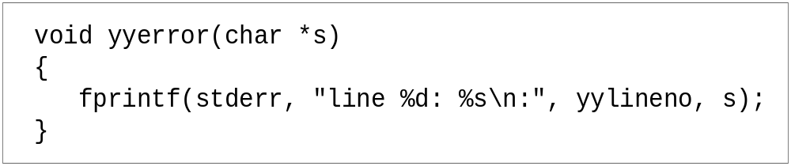
Error Messages
Bad error message:
  Syntax error
  Compiler needs to give programmer a good advice
It is better to track the line number in LEX:

Slide 119
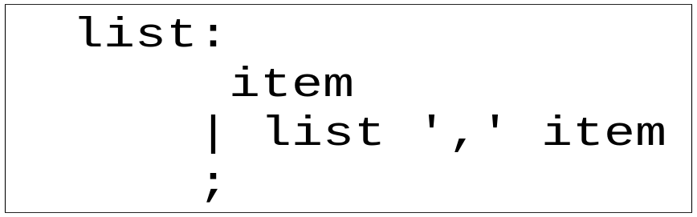
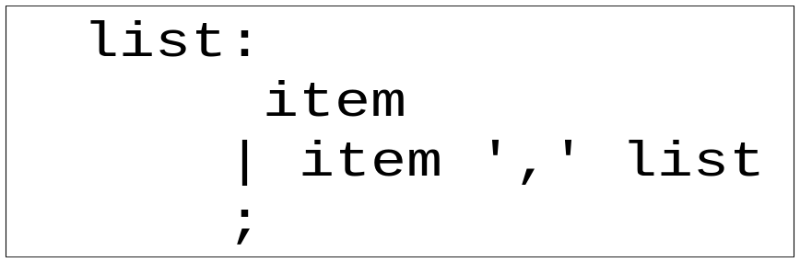
Recursive Grammar
Left recursion
Right recursion
LR parser prefers left recursion
LL parser prefers right recursion

Slide 120
YACC Example
Taken from LEX & YACC
Simple calculator
  a = 4 + 6
  a
  a=10
  b = 7
  c = a + b
  c
  c = 17

Slide 121
YACC Declaration Summary
`%start' Specify the grammar's start symbol
`%union‘ Declare the collection of data types that semantic values may have
`%token‘ Declare a terminal symbol (token type name) with no precedence or associativity specified
`%type‘ Declare the type of semantic values for a nonterminal symbol

Slide 122
YACC Declaration Summary
`%right‘ Declare a terminal symbol (token type name) that is right-associative
`%left‘ Declare a terminal symbol (token type name) that is left-associative
`%nonassoc‘ Declare a terminal symbol (token type name) that is nonassociative (using it in a way that would be associative is a syntax error, e.g.:
x op. y op. z is syntax error)

Slide 123
Commands Used:
# yacc –d filename.y
# cc y.tab.c –ly -ll
# ./a.out
Input:??

Slide 124
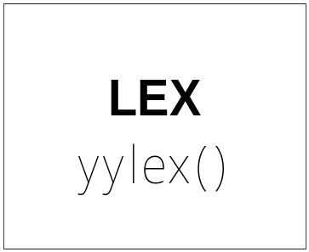
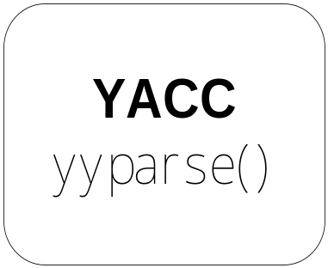
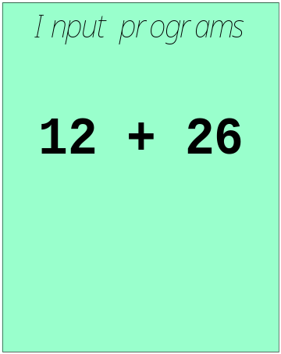
LEX and YACC: a team
How to work ?

Slide 125
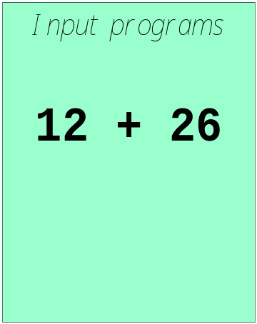
LEX and YACC: a team
call yylex()
[0-9]+
next token is NUM
NUM ‘+’ NUM

Slide 126
Operator Precedence Parsing:
Uses Operator Grammar:
Have properties :
No Production is ‘ε’ or
Has no Two (2) adjacent ‘NT’( Non-Terminals).
Uses Three Disjoint Relations

Slide 127
Uses Three Disjoint Relations
RELATION | MEANING
a < b | a “yields precedence to” b
a = b | a “has the same precedence as” b
a > b | a “takes precedence over” b

Slide 128
LR Parsers
Used for Large Class of ‘G’/ CFG.
Called LR(K) Parsing.

Slide 129
Bottom Up Con…
LR Parsers
Here (LR(K))
Scans Input from Left to Right

Slide 130
Here (LR(K))
Scans Input from Left to Right
Generates Rightmost Derivation Tree in Reverse

Slide 131
Here (LR(K))
K no of Look ahead Symbols
Scans Input from Left to Right
Generates Leftmost Derivation Tree

Slide 132
Properties of LR Parsers
Can be constructed for which it is possible to write CFG.
Most general Non-backtracking S-R parsing method.
Proper Superset of CFG that can be parsed by Predictive Parsers.
Can detect Syntactic Errors as soon as while Scanning the i/p.
Major drawback is – Too much work to construct an LR parser by hand.
Automatic Parser Generator -YACC

Slide 133
Three Types –LR Parsing are
Simple LR Parser:
Canonical LR Parser:
LALR Parser:

Slide 134
Block Schematic of LR Parser:
A table driven Predictive parser has an I/p Buffer, a Stack, a Parsing Table and O/p stream along with Driver Program.
a1 … . ai ….an $
Input
Sm
Xm
LR Parsing Program
Sm-1
Output
Xm-1
…
S0
Stack
action
goto
Parsing Table

Slide 135
Examples: ……

Slide 136
State | Action |  |  |  |  |  | Go to
 | Id | + | * | ( | ) | $ | E | T | F
0 | S5 |  |  | S4 |  |  | 1 | 2 | 3
1 |  | S6 |  |  |  | acc
2 |  | r2 | S7 |  | r1 | r2
3 |  | r4 | r4 |  | r4 | r4
4 | S5 |  |  | S4 |  |  | 8 | 2 | 3
5 |  | r6 | r6 |  | r6 | r6
6 | S5 |  |  | S4 |  |  |  | 9 | 3
7 | S5 |  |  | S4 |  |  |  |  | 10
8 |  | S6 |  |  | S11
9 |  | r1 | S7 |  | r1 | r1
10 |  | r3 | r3 |  | r3 | r3
11 |  | r5 | r5 |  | r5 | r5

Slide 137
(1) E → E * B
(2) E → E + B
(3) E → B
(4) B → 0
(5) B → 1
Parse the following input:
1 + 1*1+1$

Slide 138
state | action |  |  |  |  | goto
 | * | + | 0 | 1 | $ | E | B
0 |  |  | s1 | s2 |  | 3 | 4
1 | r4 | r4 | r4 | r4 | r4
2 | r5 | r5 | r5 | r5 | r5
3 | s5 | s6 |  |  | acc
4 | r3 | r3 | r3 | r3 | r3
5 |  |  | s1 | s2 |  |  | 7
6 |  |  | s1 | s2 |  |  | 8
7 | r1 | r1 | r1 | r1 | r1
8 | r2 | r2 | r2 | r2 | r2

Slide 139
Consider grammar G1 …
E → E + T
E → T
T → id
T → (E )
id +(id+id+id) $

Slide 140
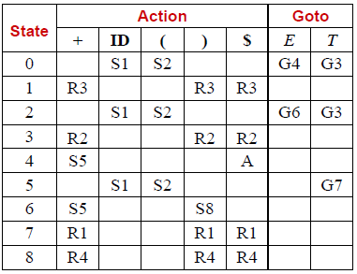

Slide 141
0) S’ →S$
1) S → aSbS
2) S → a
W = aaababa $

Slide 142
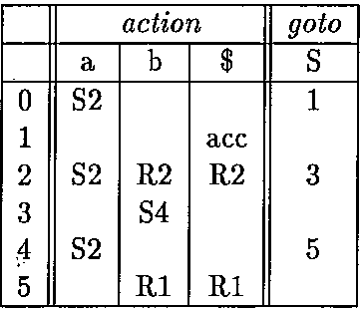

Slide 143
LR Grammar
Types of Parsers: actually Parsing Tables
SLR Parsing Table:
LR(0) Items.
Canonical Collection of LR(0) Items
- Augmented Grammar G’
-Closure() and goto() Functions.

Slide 144
Closure()
I set of items of G
Closure(I)
Initially every item of I is included in Closure(I)
Repeat
If A->α.Bβ in closure(I) and B->γ is a production, add B->.γ to closure Until no new items can be added to closure (I)

Slide 145
goto()
Goto(I,X), I set of items, X grammar symbol
Goto(I,X) := closure({A->αX.β| A->α.Xβ ∈ I})
For valid items I for viable prefix γ ,
then goto(I,X) = valid items for viable prefix γX

Slide 146
Set of Items Construction
procedure items(G’);
begin
C := closure({S->.S});
repeat
for each set of items I in C and each
grammar symbol X such that goto(I,X) is not
empty and not in C do
add goto(I,X) to C
until no more items can be added to C
end

Slide 147
E’ -> E
E -> E + T | T
T -> T * F | F
F -> (E) | id
I0 =
I1 =
I2 =
I3 =
I4 =
I5 =
I6 =
I7 =
I8 =
I9 =
I10 =
I11 =

Slide 148
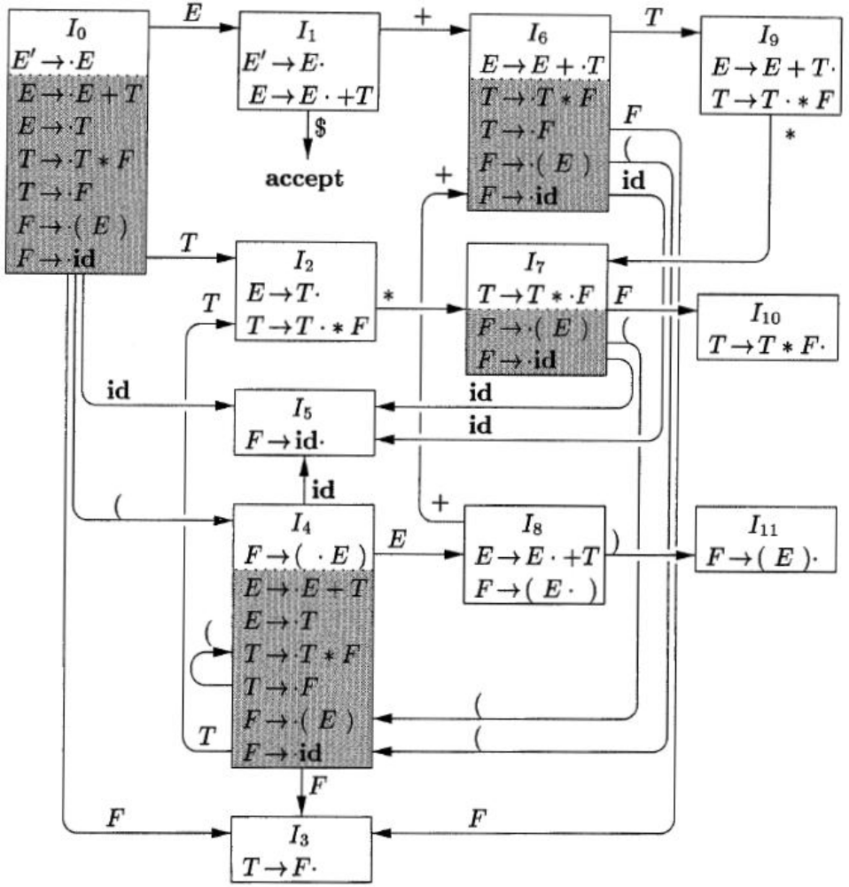
E’ -> E
E -> E + T | T
T -> T * F | F
F -> (E) | id

Slide 149
Write ALGORITHMS of
R-D Parser
Predictive Parser
S-R Parser
Operator Precedence Parser
LR Parser

Slide 150
Difference Between ( at least 6-8 )
Top Down / Bottom Up
R-D Parser / Predictive Parser
S-R Parser / Operator Precedence Parser
LR Parser

Slide 153
Example: Micro Pascal
<Program> ::= program <id> ( <id> <More_ids> ) ; <Block> .
<Block> ::= <Variables> begin <Stmt> <More_Stmts> end
<More_ids> ::= , <id> <More_ids>
| ε
<Variables> ::= var <id> <More_ids> : <Type> ; <More_Variables>
| ε
<More_Variables> ::= <id> <More_ids> : <Type> ; <More_Variables>
| ε
<Stmt> ::= <id> := <Exp>
| if <Exp> then <Stmt> else <Stmt>
| while <Exp> do <Stmt>
| begin <Stmt> <More_Stmts> end
<Exp> ::= <num>
| <id>
| <Exp> + <Exp>
| <Exp> - <Exp>

Slide 154
Parsing examples
Pos = init + / rate * 60 → id1 = id2 + / id3 * const → syntax error (exp ::= exp + exp cannot be reduced).
Pos = init + rate * 60 → id1 = id2 + id3 * const →
:=
id1
+
id2
*
id3
60

Slide 155
Semantic Analysis
Semantic analysis is applied by a compiler to discover the meaning of a program by analyzing its parse tree or abstract syntax tree.
A program without grammatical errors may not always be correct program.
  pos = init + rate * 60
  What if pos is a class while init and rate are integers?
  This kind of errors cannot be found by the parser
  Semantic analysis finds this type of error and ensure that the program has a meaning.

Slide 156
Semantic Analysis
Static semantic checks (done by the compiler) are performed at compile time
  Type checking
  Every variable is declared before used
  Identifiers are used in appropriate contexts
  Check subroutine call arguments
  Check labels
Dynamic semantic checks are performed at run time, and the compiler produces code that performs these checks
  Array subscript values are within bounds
  Arithmetic errors, e.g. division by zero
  Pointers are not dereferenced unless pointing to valid object
  A variable is used but hasn't been initialized
  When a check fails at run time, an exception is raised

Slide 157
Semantic Analysis and Strong Typing
A language is strongly typed "if (type) errors are always detected"
  Errors are either detected at compile time or at run time
  Examples of such errors are listed on previous slide
  Languages that are strongly typed are Ada, Java, ML, Haskell
  Languages that are not strongly typed are Fortran, Pascal, C/C++, Lisp
Strong typing makes language safe and easier to use, but potentially slower because of dynamic semantic checks
In some languages, most (type) errors are detected late at run time which is detrimental to reliability e.g. early Basic, Lisp, Prolog, some script languages

Slide 158
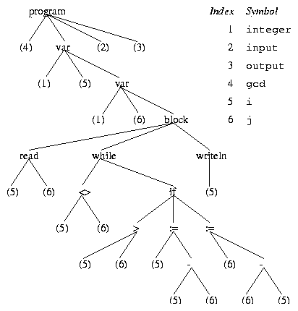
Code Generation and Intermediate Code Forms
A typical intermediate form of code produced by the semantic analyzer is an abstract syntax tree (AST)
The AST is annotated with useful information such as pointers to the symbol table entry of identifiers
Example AST for the
gcd program in Pascal

Slide 159
Code Generation and Intermediate Code Forms
  Other intermediate code forms
    intermediate code is something that is both close to the final machine code and easy to manipulate (for optimization). One example is the three-address code:
    dst = op1 op op2
    The three-address code for the assignment statement:
      temp1 = 60
      temp2 = id3 + temp1
      temp3 = id2 + temp2
      id1 = temp3
  Machine-independent Intermediate code improvement
      temp1 = id3 * 60.0
      id1 = id2 + temp1

Slide 160
Target Code Generation and Optimization
From the machine-independent form assembly or object code is generated by the compiler
      MOVF id3, R2
      MULF #60.0, R2
      MOVF id2, R1
      ADDF R2, R1
      MOVF R1, id1
This machine-specific code is optimized to exploit specific hardware features
Notes:
COP4020 Fall 2006

Slide 161
Compilation in a Nutshell 1
Source code
(character stream)
if (b == 0) a = b;
Lexical analysis
Token stream
if
(
b
==
0
)
a
=
b
;
Parsing
if
==
=
;
Abstract syntax tree
(AST)
b
0
a
b
if
Semantic Analysis
boolean
==
=
int
;
Decorated AST
int b
int 0
int a
lvalue
int b

Slide 162
Compilation in a Nutshell 2
if
boolean
int
==
=
;
int b
int 0
int a
lvalue
int b
Intermediate Code Generation
CJUMP ==
MEM
CONST
MOVE
NOP
Optimization
+
0
MEM
MEM
fp
8
+
+
fp
4
fp
8
CJUMP ==
Code generation
CX
CONST
MOVE
NOP
CMP CX, 0
CMOVZ DX,CX
0
DX
CX

Slide 163
Why Study Compilers? (1)
Compiler techniques are everywhere
  Parsing (little languages, interpreters)
  Database engines
  AI: domain-specific languages
  Text processing
    Tex/LaTex -> dvi -> Postscript -> pdf
  Hardware: VHDL; model-checking tools
  Mathematics (Mathematica, Matlab)

Slide 164
Why Study Compilers? (2)
Fascinating blend of theory and engineering
  Direct applications of theory to practice
    Parsing, scanning, static analysis
  Some very difficult problems (NP-hard or worse)
    Resource allocation, “optimization”, etc.
    Need to come up with good-enough solutions

Slide 165
Why Study Compilers? (3)
Ideas from many parts of CSE
  AI: Greedy algorithms, heuristic search
  Algorithms: graph algorithms, dynamic programming, approximation algorithms
  Theory: Grammars DFAs and PDAs, pattern matching, fixed-point algorithms
  Systems: Allocation & naming, synchronization, locality
  Architecture: pipelines & hierarchy management, instruction set use
Notes:
Au02: taken from one of Cooper’s slides

Slide 166
Summary
Compiler front-end: lexical analysis, syntax analysis, semantic analysis
  Tasks: understanding the source code, making sure the source code is written correctly
Compiler back-end: Intermediate code generation/improvement, and Machine code generation/improvement
  Tasks: translating the program to a semantically the same program (in a different language).

Slide 167
Scanner: Lexical Analysis
Lexical analysis breaks up a program into tokens
  Grouping characters into non-separatable units (tokens)
  Changing a stream to characters to a stream of tokens
program gcd (input, output);
var i, j : integer;
begin
read (i, j);
while i <> j do
if i > j then i := i - j else j := j - i;
writeln (i)
end.
program gcd ( input , output ) ;
var i , j : integer ; begin
read ( i , j ) ; while
i <> j do if i > j
then i := i - j else j
:= i - i ; writeln ( i
) end .

